Slide 1

Git Good!
Presented by QC Coders

Slide 2
What is Git?
Git is a distributed version-control system for tracking changes in source code during software development.
Git was created by Linus Torvalds in 2005 for development of the Linux kernel.

Slide 3
What?
Git is storage for text based files
Files are stored in a “repository”, which is a fancy name for a folder on your computer, with some extra hidden files inside of it
Git tracks changes to files in an incremental fashion
Instead of keeping both copies of a modified file, git computes the difference between the old and new files and stores that.
Git keeps all history forever, and allows you to:
See a log of all changes, additions and deletions to both files and contents of files
Go back to a previous point in time
See the differences between any two points in time
Git allows you to synchronize your repository with a central repository

Slide 4
Why?
File backup
Review differences between versions
It worked last Tuesday, but today it’s broken. What changed?
Collaboration
Easily review changes made by others
Easily assign blame when something goes wrong
Share changes!

Slide 5
What’s So Special About Sharing?
Because Git saves file changes incrementally, it can easily handle changes made to different parts of a file, updated at the same time
Other version control systems overwrite files as a hole, which might cause changes to be lost
Example:
Bob and Alice both download a copy of a file on Tuesday
Bob updates his copy of the file Tuesday, but doesn’t upload it
Alice updates her copy of the file Wednesday and uploads it
Bob uploads his copy Thursday
What happens to Alice’s changes?
Git will merge the contents of both copies, and nothing is lost!

Slide 6
How Git Tracks Changes
Apples
Oranges
Grapes
Pears
Apples
Oranges
Grapes
Pears
Peaches
Apples
Oranges
Grapes
Pears
Peaches
Apples
Oranges
Grapes
Pears
Peaches
Apples
Oranges
Pears
Peaches

Slide 7
Anatomy of a Repository
Working Directory
(the folder with all your files)
Staging Area
Local
Repository
(.git folder)

Slide 8
Checking Out to Disk
Working Directory
(the folder with all your files)
Staging Area
Local
Repository
(.git folder)
Checkout

Slide 9
Staging Changes
Working Directory
(the folder with all your files)
Staging Area
Local
Repository
(.git folder)
Checkout
Stage

Slide 10
Committing Changes to Repository
Working Directory
(the folder with all your files)
Staging Area
Local
Repository
(.git folder)
Checkout
Stage
Commit

Slide 11
… As Commands!
Working Directory
(the folder with all your files)
Staging Area
Local
Repository
(.git folder)
git checkout
git add
git commit

Slide 12
… With a Remote Repository!
Working Directory
(the folder with all your files)
Staging Area
Local
Repository
(.git folder)
Remote Repository
(GitHub)

Slide 13
Cloning a Remote Repository
git clone
Working Directory
(the folder with all your files)
Staging Area
Local
Repository
(.git folder)
Remote Repository
(GitHub)

Slide 14
Fetching Changes
git clone
Working Directory
(the folder with all your files)
Staging Area
Local
Repository
(.git folder)
Remote Repository
(GitHub)
git fetch

Slide 15
Copying Changes
git clone
Working Directory
(the folder with all your files)
Staging Area
Local
Repository
(.git folder)
Remote Repository
(GitHub)
git fetch
git pull

Slide 16
Pushing Changes
git clone
Working Directory
(the folder with all your files)
Staging Area
Local
Repository
(.git folder)
Remote Repository
(GitHub)
git fetch
git pull
git checkout
git add
git commit
git push

Slide 17

Stash

Slide 18
Stashing and Popping
Working Directory
(the folder with all your files)
Staging Area
Local
Repository
(.git folder)
Remote Repository
(GitHub)
git stash
git stash pop
Temporary Stash

Slide 19
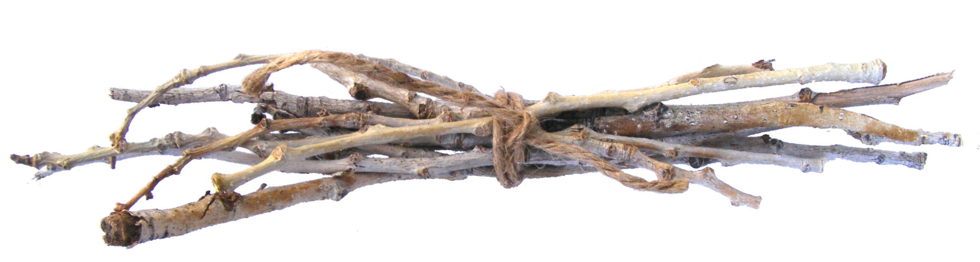
Branches

Slide 20
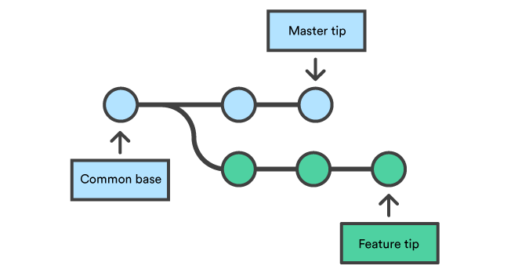
Branches

Slide 21
Basic Branch Operations
Creating a new branch
git branch <name> || git checkout <name>
git checkout –b <name>
Publishing a new branch
git push --set-upstream origin <name>
git push –u origin <name>
Switching branches
git checkout <name>
Deleting branches
git branch –d <name>
git branch –D <name>

Slide 22
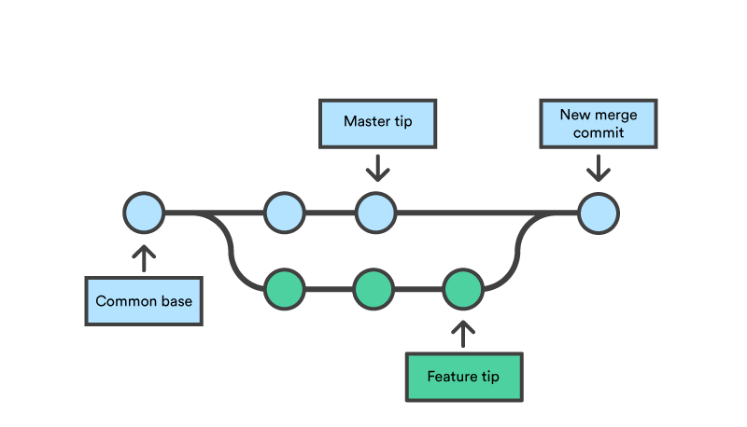
Merging

Slide 23
Merging
Create a new branch
git checkout –b branch
Add/modify a file, then commit it
git add .
git commit –m “add my file”
Look at the log
git log
Check out the branch you want to merge into
git checkout master
Look at the log (it’s not there!)
git log
Merge the new branch
git merge
Look at the log (now it’s there!)

Slide 24


Slide 25
Merge Conflicts
Bob’s Change
Alice’s Change
Apples
Oranges
Grapes
Pears
Apples
Oranges
Grapes
Pears
Apples
Oranges
Grapes
Pears
Pizza
Apples
Oranges
Grapes
Pears

Slide 26

Merge Conflicts ☺
Bob’s Change
Alice’s Change
Apples
Oranges
Grapes
Pears
Apples
Oranges
Grapes
Pears
Apples
Oranges
Grapes
Pears
Pizza
Apples
Oranges
Grapes
Pears
Apples
Grapes
Pears
Pizza

Slide 27
Merge Conflicts ☹
Bob’s Change
Alice’s Change
Apples
Oranges
Grapes
Pears
Apples
Oranges
Grapes
Pears
Apples
OrangesPizza
Grapes
Pears
Apples
OrangesCheeseburgers
Grapes
Pears

Slide 28

Merge Conflicts ☹
Bob’s Change
Alice’s Change
Apples
Oranges
Grapes
Pears
Apples
Oranges
Grapes
Pears
Apples
OrangesPizza
Grapes
Pears
Apples
OrangesCheeseburgers
Grapes
Pears
Apples
??????????
Grapes
Pears

Slide 29
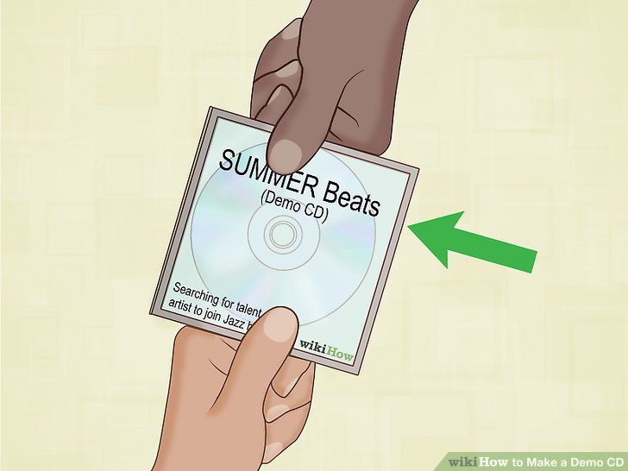

Slide 30
Questions?

